Slide 1
Nothing, The Infinite, and Limitless Light
An Illuminating Look At The Strange Case Of The Cat That’s Alive And Dead At The Same Time; a Photon’s Eye View; Black Holes And Naked Singularities; The Big Bang(s); Non-Locality; FTL Information Transfer & Teleportation; Zero Point Energy; And The Collapse Of The State Vector

Slide 2
Null
Science began whenever the first Homo sapiens became cognitively capable of perceiving cause and effect as an abstract principle. It led to initial discoveries like agriculture, and fire. Roughly a millennium ago, what we now recognize as the scientific method was begun by Ibn Al Haytham.
The scientific method is empirical, that is it deals with data obtained by observation. It is rational, that is, it analyzes data with the use of logic and mathematics. Ideas are tested empirically, and empirical findings are winnowed and interpreted rationally; science represents a system of empirical rationalism.
Key to the scientific method is the null hypothesis, which always serves as a claim’s negation, and must be falsified in order for that claim to carry the burden of proof. The standard is 3, or 5 sigma in order for a claim to carry the burden of proof.
Science is based on replicability, testability, and falsifiability. Science is driven by doubt. And it has to be. Science does not encompass certainty, by design.

Slide 3
Uncertainty+ Plus Gravity = Universes
There is only one equation I will be using for this presentation, but it may just be the most important equation we’ve discovered.
Unlike virtually all the rest, it doesn’t tell us what we can know. It tells us what we can’t.
The formula for quantum uncertainty is dx dp ≥ ħ / 2 .
Gravity, in turn, is negative energy. And Dr. Krauss has argued that the total energy of our universe may very well balance out to zero.
Hawking’ s argued that due to Uncertainty and gravity, “…the universe can and will create itself from nothing. Spontaneous creation is the reason there is something rather than nothing, why the universe exists, why we exist.”

Slide 4
Achieving Illumination.
Einstein showed that Newton’s 2nd Law, F=MA, was only true as velocity approaches 299 792 458 m / s, the speed of light.
In fact, the speed of light is the universal speed limit (kinda), and you can only get that fast if you have zero mass.
Einstein also showed that rather than gravitation being caused by an external force, it’s really caused by space and time being one single entity, spacetime. And Einstein showed that spacetime is bent by mass in it. So gravitation is really a ‘dip’ in the fabric of the universe. (under General Relativity, at least)

Slide 6
Spooky Action At A Distance
We know that nothing material can travel faster than the speed of light. Information aint material.
When two particles interact, they become entangled. Uncertainty prevents us from knowing the spin of either quanta until we measure the system, but wave collapse for one quanta will collapse the wave function for the other quanta.
According to experiments we’ve run with entangled particles, information is transferred between them at, at least, 10,000 times C, and information can be ‘teleported’.
Currently, we’re using both quantum computers and quantum cryptography. Beam me up.

Slide 7
Waves? Particles? Waveicles?
Light has been a powerful metaphor for all of human history; we still talk about “illumination”, “enlightenment” and “The Illuminati.” When we want to show that someone is holy, our artists draw a ring of light around their head.
But we didn’t know what the heck light really was, at the start of the 20th century. In fact, it was downright confusing.
When we performed certain experiments, light seemed to travel in isolated, physical pieces called “particles”: individual bits of matter, just like bullets.
But when we performed other experiments, light seemed to travel in energetic, spread out patterns in spacetime, called “waves”: just like how radio signals spread out in a spherical pattern from the transmitting antenna.

Slide 9
But Wait, It Gets Weirder!
In a famous experiment known as the Experiment With Two Slits, or Young’s Experiment, photons were sent down a pathway into a photographic plate which recorded their impact. They had to pass through one of two slits in an object in front of the plate, in order to hit it. The slits would have affected their trajectories, if photons were particles. It would have caused interference, if they were waves.
And depending on how we set up our equipment, we saw either wave or particles.
Except, if you set the experiment up juuuuuust right and sent a single particle-like photon down the path at a time, over and over again? Then something interesting happened. Something very interesting.

Slide 10
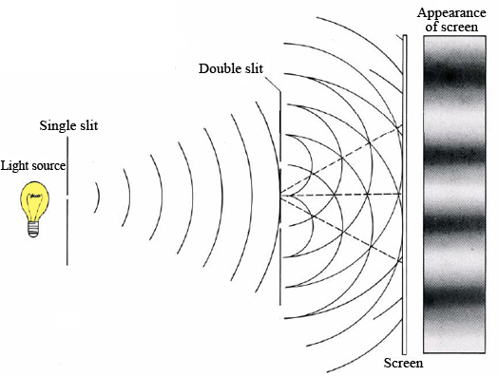
Bwah?
An interference pattern is created when two waves hit into each other, and get bigger in some places and smaller in some when we add them up.

Slide 11
So What?
So, a single photon going through either one of the slits should create a pattern like you see at a shooting range: individual particles leaving ‘holes’ where they hit, depending on the angle from which they were ‘shot’ through the two slits.
But that is only what we see at FIRST. If we repeat the experiment over and over and over again?

Slide 13
You Are Only Coming Through In Waves
What we see is an interference pattern, which Is caused by the photon interfering with itself. But interference patterns are created by the impact of two separate wavefronts. That means a photon can somehow not only be in two places at the exact same time, it can ‘crash into’ itself, too.
In fact, this shows that a photon can behave as both a particle, and a wave, at the same exact time. This suggests that, at a certain level, the very categories we normally use to describe reality itself are, simply, fundamentally and necessarily inaccurate.
The map is not the territory. The menu is not the meal.

Slide 15
Wait, lolwut?
Yep. A single thing can, somehow, not only be in two places at the same exact time, but be solid and self contained at the same exact moment that it’s energetic and spread out. Seriously.
Even stranger, equations discovered by Richard Feynman, called the Sum Over Many Paths model, show us that the photon doesn’t even travel straight from A to B. In fact, the photon travels an infinite number of paths though spacetime, which, when added up, equal the path that it ‘appears’ to take.

Slide 16
They’ve Gone to Ludicrous Speed!
It turns out that light is very, very special. We know that, in a vacuum, light will always be measured as having the speed, C, which is roughly 300,000,000 m/s. (or about six hundred million miles in a single hour). For comparison, 600,000,000 miles is the distance of about 118,279 round trip car rides from New York to L.A.
But the real reason that light’s special? Nothing else acts quite the same. If a truck is going 70mph on Mopac and you’re going 60, you’ll measure it as going 10 mph faster than you. If you accelerate to 70, now you’ll measure the truck as having the same speed as you.
Simple, right?

Slide 17
Simple, Meet Wacky.
But light? Light’s a whole other matter than trucks and cars, and you and me. If you’re standing still, you will measure light as moving at about 300,000,000 m/s.
And if you accelerate to 299,999,999 m/s? Light will still be going 300,000,000 m/s faster than you. No matter what.
And if two people are moving at different speeds, in different directions? They will still both measure light as having the same exact speed.
What the heck does that mean? It means that a photon’s eye view of the world is stranger than we know.

Slide 19
He Is The Kwisatz Haderach
What this means is that, to a photon moving at light speed, nothing else is moving. And the entire cosmos is contracted to a single point.
So, in a very real sense, a photon, which can be in more than one place at the same time and which moves through an infinite number of paths to get from point A to B, ‘sees’ all of reality, from the beginning of time to the end, spread out and unchanging.
How, then, do things change if from a photon’s point of view, the entire rest of the universe is stuck still and never moves at all?

Slide 20
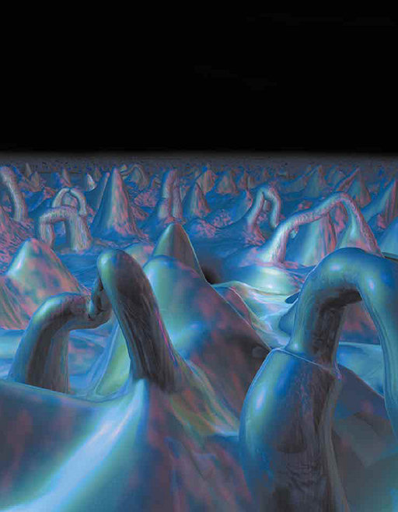
And That’s Not All!
On the Planck scale of distance, space isn’t flat like Newton thought, or even curved like Einstein thought. Space is boiling, bubbling, seething. We call it the Quantum Foam.

Slide 22
Ahhh… Foamy!
No, not that Foamy.
But it also turns out that, out of the foam, come something we call virtual particles.
Virtual particles are created out of quantum vacuum fluctuations. That is, literally out of nothingness. The two particles are opposites, called antiparticles. They destroy each other when they touch. But when they do, they release one photon.
Even the emptiest, darkest spaces are therefore full. And radiant, if we could only see clearly.

Slide 23
Zero
Any closed system will tend to approach its level of lowest free energy, its ground state.
But Uncertainty prohibits us from having perfect knowledge of a system, even for the ground state.
And so the ground state for quanta actually includes a vast amount of energy, known as Zero Point Energy.
While we don’t know how (or if we can) extract zero point energy, we do know that the Casimir Effect has been observed, and its implications are still being hotly debated.

Slide 25
Well, Maaaaaaybe. But that’s Just Photons. Right?
Nyet. Heisenberg’s equation, (physics, not meth), governs all quanta. That means nerve impulses propagate probabilistically through your synapses. And the atoms in your body travel probabilistically, too, as you walk down the street.
This doesn’t have to do with our equipment, or eyesight, or anything else. Uncertainty is fundamental to reality, and can not be avoided.
Perfect knowledge is therefore, impossible. We talk in terms of probabilities instead.

Slide 27
But Wait, It Gets Weirder.
Uncertainty is tied with Schrodinger’s wave equations, and both are connected to something called wave function collapse, or the collapse of the state vector.
A quantum wave function exists in a state of uncertainty before we measure and check.
Keep in mind, the state vector represents how the whole system is changing.

Slide 29
Hey, That’s Not So Weird!
Is too!!!
What’s really interesting about the state vector is that observation/measurement “collapses” it into one certain state, called an eigenstate or eigenvalue.
What’s really weird about the state vector is that before we collapse it into just one eigenstate, every possible reality exists, at the same time, ‘on top of each other’.
We call this “superposition of states”. It certainly appears to be as real as radio, another thing we cannot directly see normally. But just like Radio, this phenomena has macroscopic effects which have been observed.
If the math is correct, and multiple realities exist at the same time until we choose one… what happens to the others, and where do they go?

Slide 30
Here Kitty, Kitty, Kitty! (It. Gets. Weirder.)
Erwin Schrodinger came up with a famous ‘thought experiment’ (an idea that you don’t actually try). It’s now known as Schrodinger’s Cat.
Schrodinger’s Cat is put in a box with an atom that has a 50/50 chance of decaying and giving off radiation. If radiation is detected by a Geiger counter, a bottle of poison gas will be opened, and the cat will die.
BUT! Until we open the box? The cat is both alive and dead, at the same time. It is only after we open the box and remove uncertainty that we select which eigenstate we really live in. And whether or not fluffy is living in it with us.

Slide 32
It. Gets. Weirder!
But before we open the box and observe it, not only is the Cat both alive and dead (fully alive and fully dead, at the exact same moment), not only is the photon solid and spread out and in an infinite number of places at the same time, but our universe is almost certainly not the only one.
Yep.
The math behind inflation, which shows how the Big Bang happened, strongly suggests that the BB was not an isolated event. In fact, inflation’s creator Dr. Guth is correct, there have been an infinite number of Big Bangs, and they’re still happening. Which would mean that our universe is only one of many, many, many, many other possible universes. A multiverse.
In one universe, maybe you’re Batman.

Slide 33
No More Weirdness?
We aint done yet. Recently there was a debate between two scientists, Leonard Susskind and Stephen Hawking. Hawking argued that the Information for particles that fall into a black hole is lost forever. Gone. Susskind argued that there is Conservation of Information just like momentum and energy are conserved.
Susskind won the debate.
He proved that Conservation of Information is as solid as Conservation of Energy. It may be just as important.

Slide 35
Whoa. Déjà Vu.
It turns out that, as matter falls into a black hole, spacetime bends so much that time ‘stops’ at the edge of a black hole, called the Event Horizon. So to an outside observer, matter never quite falls into the black hole. But, at the same time, any matter at the event horizon really is sucked in.
The Cat is both alive and Dead. The photon is a particle and a wave at the same time.
And so, in a very real sense, matter is both torn to pieces by a black hole… and it exists on the ‘skin’ of the black hole, as pure Information, for as long as the black hole exists (black holes evaporate by a process called Hawking Radiation).

Slide 36
Should’ve Gone To Wonderland

Slide 37
Just One Single Particle…

Slide 44
Oh, Is That All?
Nope. It turns out, that Information is stored holographically at the edge of a black hole. And holographs are really, really interesting. Essentially, in a holograph, any one point contains the data for every point; put a holograph into a pane of glass and shatter it? Even the smallest splinter of glass will contain the entire picture.
That means that thinking of ‘separate things’ within a holograph is inaccurate.
And so, in terms of Information stored at the edge of a black hole: difference, identity and individuality may all be dissolved, as all information becomes both interrelated and interpenetrated.

Slide 45
As Above, So Below

Slide 46
Twas Brillig, And The Slithy Toves Did Gyre And Gimble In The Wabe.
A black hole is pretty much just a singularity with a ‘veil’ we can’t see past, the Event Horizon.
The Big Bang was (most likely) a naked singularity, that is, it had no Event Horizon. But there is strong evidence that all the Information in our entire universe is stored, as a holograph, on the ‘skin’ of the universe.
But remember, space and time are one thing, spacetime. And our universe represents all of the spacetime we have. So speaking about ‘before’ or ‘after’ our universe, in a very real way, makes no sense. From a certain point of view, it seems that the holograph of the information that is you, me, and everything else? It’s beyond time as we comprehend it.

Slide 47
Omnia Quia Sunt Lumina Sunt
The current model of cosmogenesis says that before the Big Bang, our entire universe was a massive amount of matter crammed into a very, very small radius. That radius is called the Swartzchild Radius. Any amount of mass compressed to its Schwartzchild Radius forms a singularity. Singularities bend spacetime infinitely, to the point where not even light can escape the curvature. In other words, we live in a black hole. Which should, in turn, have its information represented holograhipcally. And holographs are photonically mediated.

Slide 48
The Left Hand Of Nothingness

Slide 49
Take The Red Pill
And I haven’t even mentioned Dr. Gates’ finding that, when the fundamental equations of physics are represented graphically in adinkras, our universe appears to be coded in binary.
It may begin to appear, from a certain point of view, that the one true essence of reality is information, paradoxically dovetailed with its one true operating principle, uncertainty.
Ah, what a world.

Slide 51
And… So?
So… if we are living inside a singularity; if singularities store Information holographically; if the Cat is both alive and dead at the same time; if a photon can be both here, there and everywhere at the same time; if we are one with an inseparable sea of Information, what does that mean we are? What is it to be alive and aware?
Perhaps, just as the Cat is alive and dead at the same time, just like the photon is a wave and a particle at the same time… perhaps we are, likewise limited, mortal, and bound to one single life, and at the exact same time, boundless, eternal and one essential, inseparable part of the cosmos. Perhaps some of our categories themselves no longer make sense as we learn more about the world around us, and we must begin to accept that the universe is bigger and stranger than we’d ever thought possible.
Perhaps.

