Slide 2
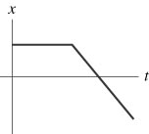
QuickCheck 2.4
A graph of position versus time for a basketball player moving down the court appears as follows:
Which of the following velocity graphs matches the position graph?
A.
B.
C.
D.
Notes:
Answer: C

Slide 3
QuickCheck 2.4
A graph of position versus time for a basketball player moving down the court appears as follows:
Which of the following velocity graphs matches the position graph?
A.
B.
C.
D.

Slide 4
QuickCheck 2.5
The slope at a point on a position-versus-time graph of an object is
The object’s speed at that point.
The object’s velocity at that point.
The object’s acceleration at that point.
The distance traveled by the object to that point.
I am not sure.
Notes:
4
Answer: B

Slide 5
QuickCheck 2.5
The slope at a point on a position-versus-time graph of an object is
The object’s speed at that point.
The object’s velocity at that point.
The object’s acceleration at that point.
The distance traveled by the object to that point.
I am not sure.
Notes:
5

Slide 6
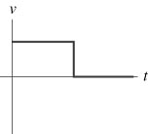
QuickCheck 2.6
A graph of velocity versus time for a hockey puck shot into a goal appears as follows:
Which of the following position graphs matches the velocity graph?
A.
B.
C.
D.
Notes:
Answer: D

Slide 7
QuickCheck 2.6
A graph of velocity versus time for a hockey puck shot into a goal appears as follows:
Which of the following position graphs matches the velocity graph?
A.
B.
C.
D.
(d)

Slide 8
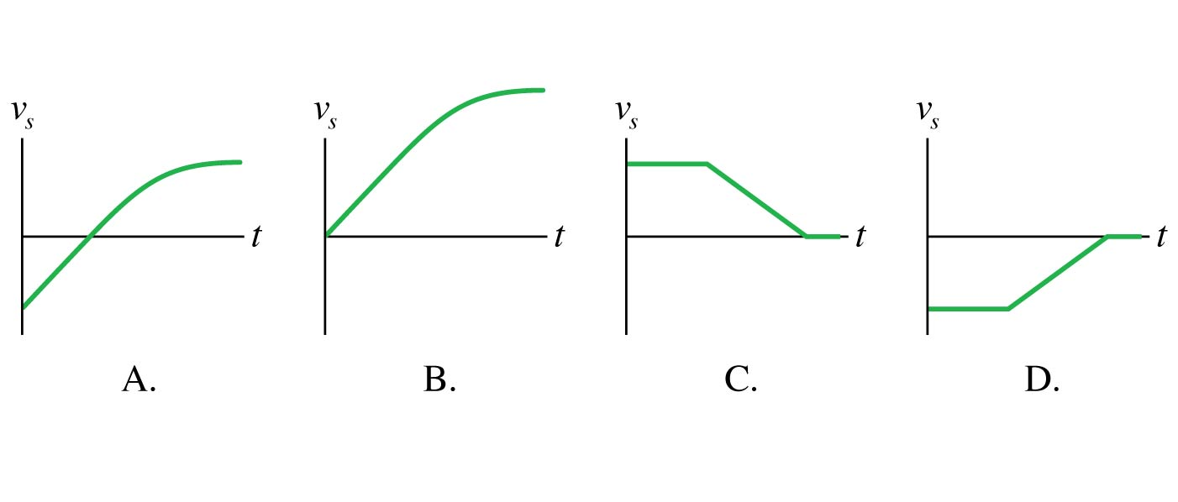
QuickCheck 2.7
Which velocity-versus-time graph goes with this position graph?
Notes:
8
Answer: C

Slide 9
QuickCheck 2.7
Which velocity-versus-time graph goes with this position graph?
C.
Notes:
9

Slide 10
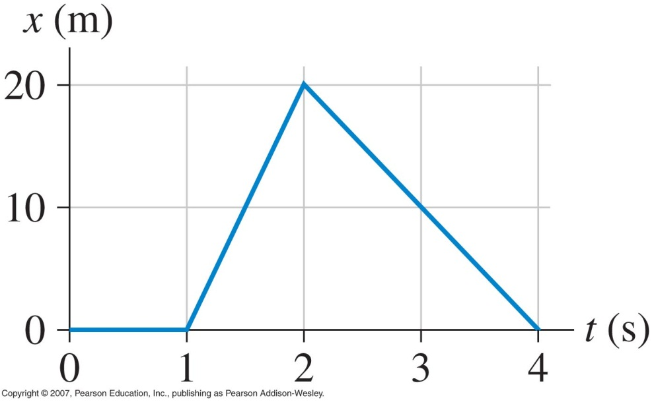
QuickCheck 2.8
Here is a position graph of an object:
At t = 1.5 s, the object’s velocity is
40 m/s
20 m/s
10 m/s
–10 m/s
None of the above
Notes:
10
Answer: B

Slide 11
QuickCheck 2.8
Here is a position graph of an object:
At t = 1.5 s, the object’s velocity is
40 m/s
20 m/s
10 m/s
–10 m/s
None of the above
Notes:
11

Slide 12
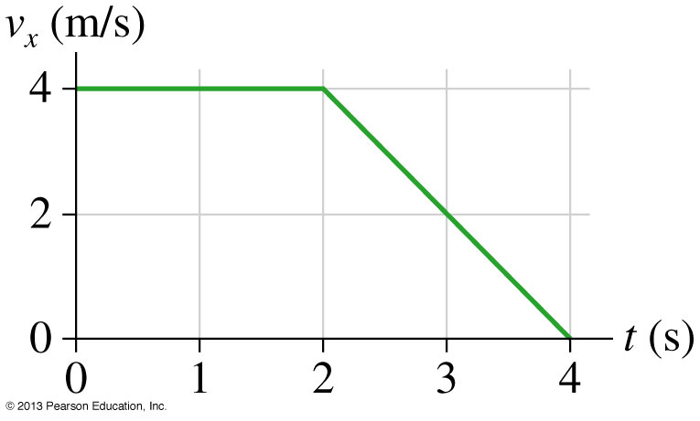
QuickCheck 2.11
Here is the velocity graph of an object that is at the origin (x = 0 m) at t = 0 s.
At t = 4.0 s, the object’s position is
20 m
16 m
12 m
8 m
4 m
Notes:
12
Answer: C

Slide 13
QuickCheck 2.11
Here is the velocity graph of an object that is at the origin (x = 0 m) at t = 0 s.
At t = 4.0 s, the object’s position is
20 m
16 m
12 m
8 m
4 m
Displacement = area under the curve
Notes:
13

Slide 14
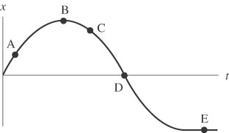
QuickCheck 2.13
A car moves along a straight stretch of road. The following graph shows the car’s position as a function of time:
At what point (or points) do the following conditions apply?
The displacement is zero.
The speed is zero.
The speed is increasing.
The speed is decreasing.

Slide 15
QuickCheck 2.13
A car moves along a straight stretch of road. The following graph shows the car’s position as a function of time:
At what point (or points) do the following conditions apply?
The displacement is zero. D
The speed is zero. B, E
The speed is increasing. C
The speed is decreasing. A

Slide 16
QuickCheck 2.19
A cart slows down while moving away from the origin. What do the position and velocity graphs look like?
Notes:
Answer: D

Slide 17
QuickCheck 2.19
A cart slows down while moving away from the origin. What do the position and velocity graphs look like?
D.

Slide 18
QuickCheck 2.20
A cart speeds up toward the origin. What do the position and velocity graphs look like?
Notes:
Answer: C

Slide 19
QuickCheck 2.20
A cart speeds up toward the origin. What do the position and velocity graphs look like?
C.

Slide 20
QuickCheck 2.21
A cart speeds up while moving away from the origin. What do the velocity and acceleration graphs look like?
Notes:
Answer: B

Slide 21
QuickCheck 2.21
A cart speeds up while moving away from the origin. What do the velocity and acceleration graphs look like?
B.

Slide 22
QuickCheck 2.23
A cart slows down while moving away from the origin. What do the velocity and acceleration graphs look like?
Notes:
Answer: C

Slide 23
QuickCheck 2.23
A cart slows down while moving away from the origin. What do the velocity and acceleration graphs look like?
C.

Slide 24
QuickCheck 2.24
A cart speeds up while moving toward the origin. What do the velocity and acceleration graphs look like?
Notes:
Answer: C

Slide 25
QuickCheck 2.24
A cart speeds up while moving toward the origin. What do the velocity and acceleration graphs look like?
C.

Slide 26
QuickCheck 2.25
Which velocity-versus-time graph goes with this acceleration graph?
Notes:
Answer: E

Slide 27
QuickCheck 2.25
Which velocity-versus-time graph goes with this acceleration graph?
E.

Slide 28
QuickCheck 2.26
A ball is tossed straight up in the air. At its very highest point, the ball’s instantaneous acceleration a_{y} is
Positive.
Negative.
Zero.
Notes:
Answer: B

Slide 29
QuickCheck 2.26
A ball is tossed straight up in the air. At its very highest point, the ball’s instantaneous acceleration a_{y} is
Positive.
Negative.
Zero.

Slide 30
QuickCheck 2.27
An arrow is launched vertically upward. It moves straight up to a maximum height, then falls to the ground. The trajectory of the arrow is noted. At which point of the trajectory is the arrow’s acceleration the greatest? The least? Ignore air resistance; the only force acting is gravity.
Notes:
Answer: Same at all points.

Slide 31
QuickCheck 2.27
An arrow is launched vertically upward. It moves straight up to a maximum height, then falls to the ground. The trajectory of the arrow is noted. At which point of the trajectory is the arrow’s acceleration the greatest? The least? Ignore air resistance; the only force acting is gravity.
Same at all points.

Slide 32
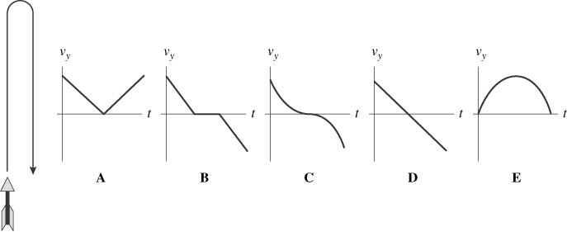
QuickCheck 2.28
An arrow is launched vertically upward. It moves straight up to a maximum height, then falls to the ground. The trajectory of the arrow is noted. Which graph best represents the vertical velocity of the arrow as a function of time? Ignore air resistance; the only force acting is gravity.
Notes:
Answer: D

Slide 33
QuickCheck 2.28
An arrow is launched vertically upward. It moves straight up to a maximum height, then falls to the ground. The trajectory of the arrow is noted. Which graph best represents the vertical velocity of the arrow as a function of time? Ignore air resistance; the only force acting is gravity.
D

