Slide 1
Kinematics
Kinematics is the branch of mechanics that describes the motion of objects without necessarily discussing what causes the motion.
1-Dimensional Kinematics (or 1-Dimensional motion) refers to motion in a straight line.

Slide 2
There are two kinds of quantities…
Scalars are quantities that have magnitude only, such as
position
distance
speed
time
mass
Vectors are quantities that have both magnitude and direction, such as
displacement
velocity
acceleration

Slide 3
Notating vectors
This is how you notate a vector…
This is how you draw a vector…
R R
R
head
tail

Slide 4
Distance
The total length of the path traveled by an object is called distance.
“How far have you walked?” is a typical distance question.
The SI unit of distance is the meter (m).

Slide 5
Position
The location of an object.

Slide 6
Displacement (Δx)
The change in the position of a particle is called displacement.
Δ is a Greek letter used to represent the words “change in”. Δx therefore means “change in x”. It is always calculated by final value minus initial value.
“How far are you from home?” is a typical displacement question.
The SI unit for displacement is the meter.
Calculation of displacement:

Slide 7
Average Speed
Average speed describes how fast a particle is moving. The equation is:
Average speed is always a positive number.
Where
= average speed
d = distance
Δt = elapsed time
The SI unit of speed is m/s

Slide 8
Average Velocity
Average velocity describes how fast the displacement is changing. The equation is:
Average velocity is + or – depending on direction.
where:
= average velocity
Δx = displacement
Δt = elapsed time
The SI unit of velocity is m/s.

Slide 9
Graphical Problem
x
t
Demonstrate the motion of this particle.

Slide 10
Graphical Problem
x
t
Demonstrate the motion of this particle.

Slide 11
Graphical Problem
B
x
slope
v_{ave} = Δx/Δt
A
Δx
Δt
t
What physical feature of the graph gives the constant velocity from A to B?

Slide 12
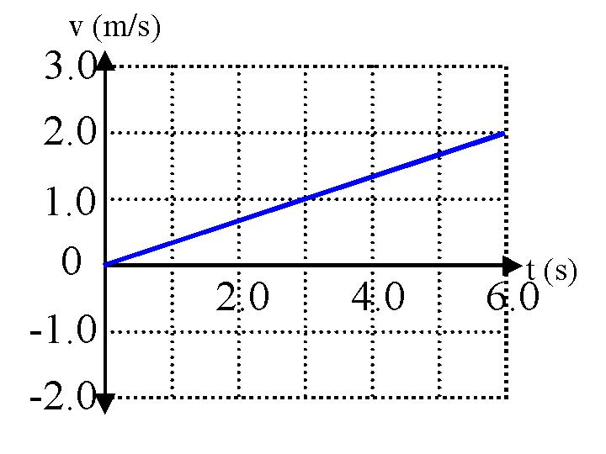
Graphical Problem: Determine the average velocity from the graph.
x (m)

Slide 13
Graphical Review Problem
x
t
Demonstrate the motion of these two particles.

Slide 14
Graphical Problem
v
t
Demonstrate the motion of these two particle.

Slide 15
Graphical Problem
x
t
What kind of motion does this graph represent?

Slide 16
Graphical Problem
A
x
v_{ave} = Δx/Δt
B
Δx
Δt
t
Can you determine average velocity from the time at point A to the time at point B from this graph?

Slide 17
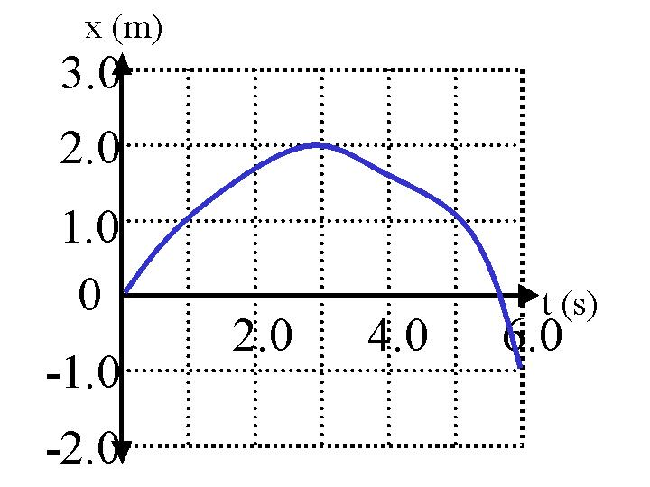
Graphical Problem: Determine the average velocity between 1 and 4 seconds.

Slide 18
Instantaneous Velocity
The velocity at a single instant in time.
If the velocity is uniform, or constant, the instantaneous velocity is the same as the average velocity.
If the velocity is not constant, than the instantaneous velocity is not the same as the average velocity, and we must carefully distinguish between the two.

Slide 19
Instantaneous Velocity
v_{ins} = Δx/Δt
x
B
Δx
Δt
t
Draw a tangent line to the curve at B. The slope of this line gives the instantaneous velocity at that specific time.

Slide 20
Practice Problem: Determine the instantaneous velocity at 1.0 second.

Slide 21
Acceleration (a)
Any change in velocity over a period of time is called acceleration.
The sign (+ or -) of acceleration indicates its direction.
Acceleration can be…
speeding up
slowing down
turning

Slide 22
Graphical Problem
v (m/s)
0.50
t (s)
Demonstrate the motion of this particle. Is it accelerating?

Slide 23
Graphical Problem
v
t
Demonstrate the motion of this particle. Is it accelerating?

Slide 24
Graphical Problem
B
v
a = Δv/Δt
A
Δv
Δt
t
What physical feature of the graph gives the acceleration?

Slide 25
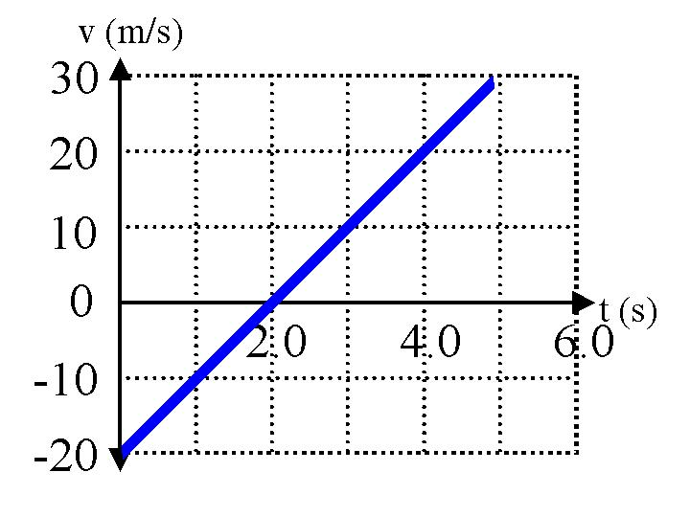
Practice Problem: Determine the acceleration from the graph.

Slide 26
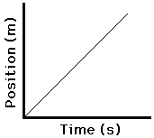
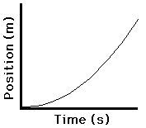
Position vs Time Graphs
Particles moving with no acceleration (constant velocity) have graphs of position vs time with one slope. The velocity is not changing since the slope is constant.
Position vs time graphs for particles moving with constant acceleration look parabolic. The instantaneous slope is changing. In this graph it is increasing, and the particle is speeding up.

Slide 27
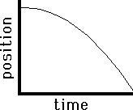
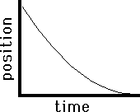
Describe the motion
This object is moving in the positive direction and accelerating in the positive direction (speeding up).
This object is moving in the negative direction and accelerating in the negative direction (speeding up).
This object is moving in the negative direction and accelerating in the positive direction (slowing down).

Slide 28
Draw Graphs for Stationary Particles
x
v
a
t
t
t
Position
vs
time
Velocity
vs
time
Acceleration
vs
time

Slide 29
Draw Graphs for Constant Non-zero Velocity
x
v
a
t
t
t
Position
vs
time
Velocity
vs
time
Acceleration
vs
time

Slide 30
Draw Graphs for Constant Non-zero Acceleration
x
v
a
t
t
t
Position
vs
time
Velocity
vs
time
Acceleration
vs
time

Slide 31
Area under curves
The area under a velocity-time represents displacement. Distance can be calculated also; just disregard the negatives.
The area under an acceleration time graph represents the change in velocity of an object.

Slide 32
Practice Problem: Determine the displacement of the object from 0 to 4 seconds.
How would you describe the motion of this particle?

Slide 33
Questions
If acceleration is zero, what does this mean about the motion of an object?
Is it possible for a racecar circling a track to have zero acceleration?

Slide 34
Uniform (Constant) Acceleration
In AP Physics 1, we will generally assume that acceleration is constant.
With this assumption we are free to use this equation:
The SI unit of acceleration is m/s².

Slide 35
Acceleration in 1-D Motion has a sign!
Think-Pair-Share:
If the sign of the velocity and the sign of the acceleration is the same, what is happening to the speed of the object?
If the sign of the velocity and the sign of the acceleration are different, what is happening to the speed of the object?

Slide 36
Kinematic Equations

Slide 37
Practice Problem: A 747 airliner reaches its takeoff speed of 180 mph in 30 seconds. What is its average acceleration?

Slide 38
Practice Problem: A horse is running with an initial velocity of 11 m/s, and begins to accelerate at –1.81 m/s². How long does it take the horse to stop?

Slide 39
Practice Problem: A plane is flying in a northwest direction when it lands, touching the end of the runway with a speed of 130 m/s. If the runway is 1.0 km long, what must the acceleration of the plane be if it is to stop while leaving ¼ of the runway remaining as a safety margin?

Slide 40
Practice Problem: On a ride called the Detonator at Worlds of Fun in Kansas City, passengers accelerate straight downward from 0 to 20 m/s in 1.0 second.
What is the average acceleration of the passengers on this ride?
How fast would they be going if they accelerated for an additional second at this rate?

Slide 41
Practice Problem: You are driving through town at 12.0 m/s when suddenly a ball rolls out in front of you. You apply the brakes and decelerate at 3.5 m/s².
How far do you travel before stopping?
When you have traveled only half the stopping distance, what is your speed?
How long does it take you to stop?

Slide 42
Free Fall
Free fall is a term we use to indicate that an object is falling under the influence of gravity, with gravity being the only force on the object.
Gravity accelerates the object toward the earth the entire time it rises, and the entire time it falls.
The acceleration due to gravity near the surface of the earth has a magnitude of 9.8 m/s². The direction of this acceleration is DOWN.
Air resistance is ignored.

Slide 43
Vectors
On the way up
On the way down
Add acceleration and velocity vectors to the picture of a ball that is thrown up and falls straight back down.

Slide 44
Symmetry in Free Fall
When something is thrown straight upward under the influence of gravity, and then returns to the thrower, this is very symmetric.
The object spends half its time traveling up; half traveling down.
Velocity when it returns to the ground is the opposite of the velocity it was thrown upward with.
Acceleration is 9.8 m/s² and directed DOWN the entire time the object is in the air!

Slide 45
Practice Problem: You drop a ball from rest off a 120 m high cliff. Assuming air resistance is negligible,
how long is the ball in the air?
what is the ball’s speed and velocity when it strikes the ground at the base of the cliff?

Slide 46
Practice Problem: You throw a ball straight upward into the air with a velocity of 20.0 m/s, and you catch the ball some time later.
How long is the ball in the air?
How high does the ball go?
What is the ball’s velocity when you catch it?

