Slide 1
Pop Quiz!
1D Kinematics
Vectors & Relative Motion 2D Kinematics

Slide 2
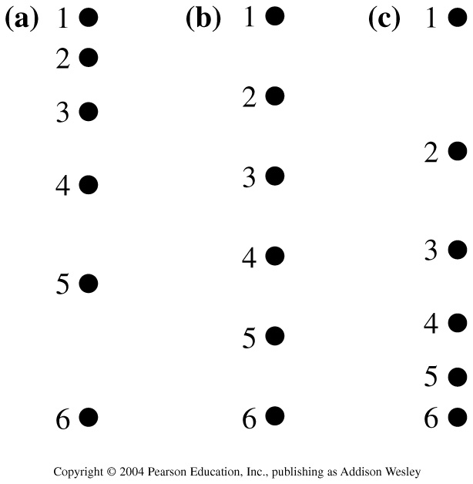
Three motion diagrams are shown. Which is a dust particle settling to the floor at constant speed, which is a ball dropped from the roof of a building, and which is a descending rocket slowing to make a soft landing on Mars?
A. (a) is dust, (b) is ball, (c) is rocket
B. (a) is ball, (b) is dust, (c) is rocket
C. (a) is rocket, (b) is dust, (c) is ball
D. (a) is rocket, (b) is ball, (c) is dust
E. (a) is ball, (b) is rocket, (c) is dust
Notes:
STT1.2

Slide 3
Three motion diagrams are shown. Which is a dust particle settling to the floor at constant speed, which is a ball dropped from the roof of a building, and which is a descending rocket slowing to make a soft landing on Mars?
A. (a) is dust, (b) is ball, (c) is rocket
B. (a) is ball, (b) is dust, (c) is rocket
C. (a) is rocket, (b) is dust, (c) is ball
D. (a) is rocket, (b) is ball, (c) is dust
E. (a) is ball, (b) is rocket, (c) is dust
Notes:
STT1.2

Slide 4
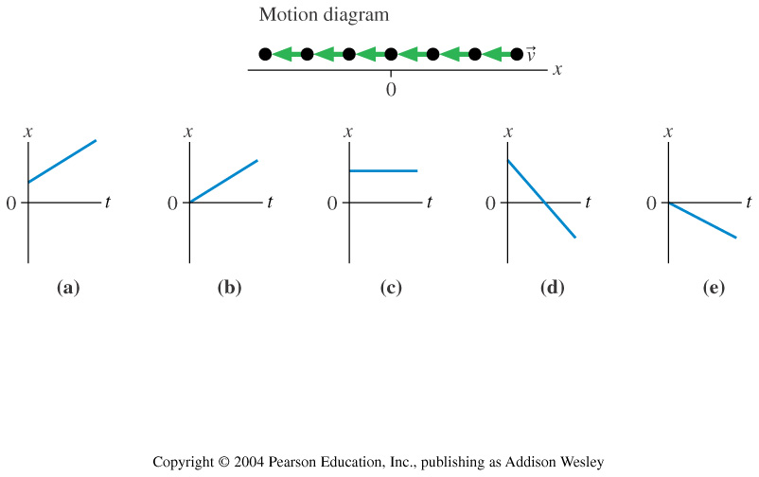
Which position-versus-time graph represents the motion shown in the motion diagram?
Notes:
STT2.1

Slide 5
Which position-versus-time graph represents the motion shown in the motion diagram?
Notes:
STT2.1

Slide 6
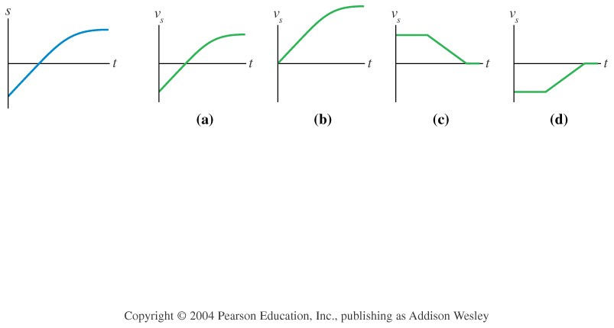
Which velocity-versus-time graph goes with this position-versus-time graph on the left?
Notes:
STT2.2

Slide 7
Which velocity-versus-time graph goes with this position-versus-time graph on the left?
Notes:
STT2.2

Slide 8
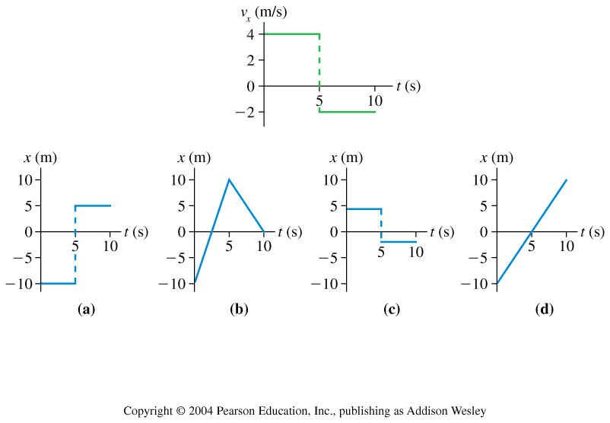
Which position-versus-time graph goes with this velocity-versus-time graph on the left? The particle’s position at t_{i} = 0 s is x_{i} = –10 m .
Notes:
STT2.3

Slide 9
Which position-versus-time graph goes with this velocity-versus-time graph on the left? The particle’s position at t_{i} = 0 s is x_{i} = –10 m .
Notes:
STT2.3

Slide 10
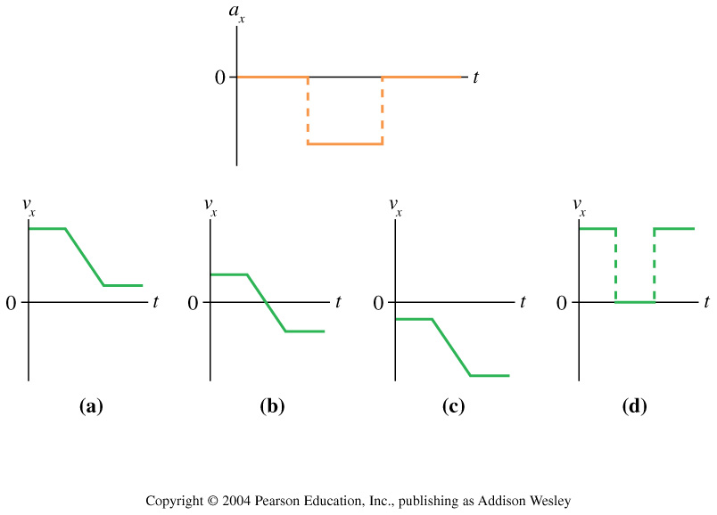
Which velocity-versus-time graph or graphs goes with this acceleration-versus-time graph? The particle is initially moving to the right and eventually to the left.
Notes:
STT2.4

Slide 11
Which velocity-versus-time graph or graphs goes with this acceleration-versus-time graph? The particle is initially moving to the right and eventually to the left.
Notes:
STT2.4

Slide 12
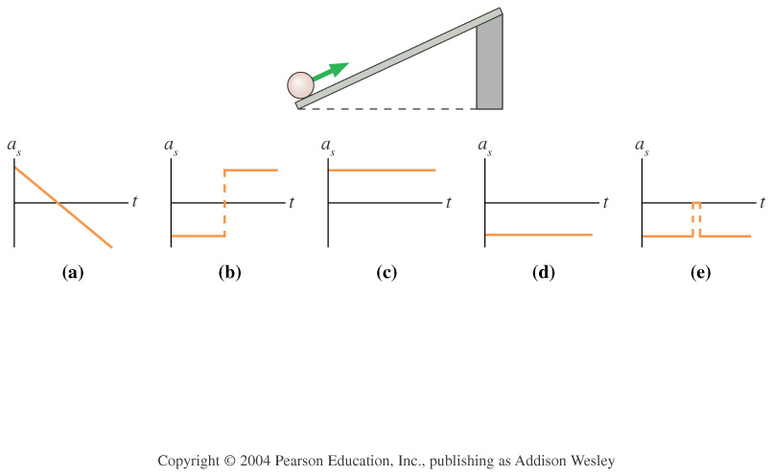
The ball rolls up the ramp, then back down. Which is the correct acceleration graph?
Notes:
STT2.5

Slide 13
The ball rolls up the ramp, then back down. Which is the correct acceleration graph?
Notes:
STT2.5

Slide 14
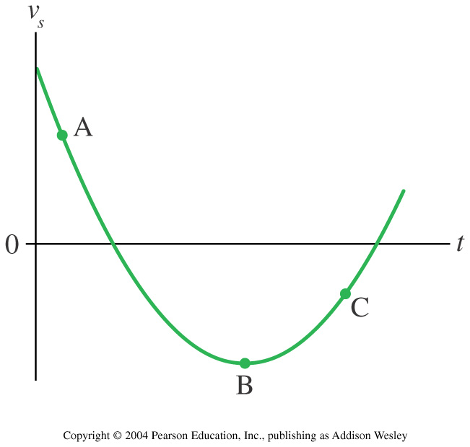
Rank in order, from largest to smallest, the accelerations a_{A}– a_{C} at points A – C.
a_{A} > a_{B} > a_{C}
a_{C} > a_{A} > a_{B}
a_{C} > a_{B} > a_{A}
a_{B} > a_{A} > a_{C}
Notes:
STT2.6

Slide 15
Rank in order, from largest to smallest, the accelerations a_{A}– a_{C} at points A – C.
a_{A} > a_{B} > a_{C}
a_{C} > a_{A} > a_{B}
a_{C} > a_{B} > a_{A}
a_{B} > a_{A} > a_{C}
Notes:
STT2.6

Slide 16
The slope at a point on a position-versus-time graph of an object is
the object’s speed at that point.
the object’s average velocity at that point.
the object’s instantaneous velocity at that point.
the object’s acceleration at that point.
the distance traveled by the object to that point.
Notes:
IG2.1

Slide 17
The slope at a point on a position-versus-time graph of an object is
the object’s speed at that point.
the object’s average velocity at that point.
the object’s instantaneous velocity at that point.
the object’s acceleration at that point.
the distance traveled by the object to that point.
Notes:
IG2.1

Slide 18
The area under a velocity-versus-time graph of an object is
the object’s speed at that point.
the object’s acceleration at that point.
the distance traveled by the object.
the displacement of the object.
This topic was not covered in this chapter.
Notes:
IG2.2

Slide 19
The area under a velocity-versus-time graph of an object is
the object’s speed at that point.
the object’s acceleration at that point.
the distance traveled by the object.
the displacement of the object.
This topic was not covered in this chapter.
Notes:
IG2.2

Slide 20
At the turning point of an object,
the instantaneous velocity is zero.
the acceleration is zero.
Both A and B.
Neither A nor B.
This topic was not covered in this chapter.
Notes:
IG2.3

Slide 21
At the turning point of an object,
the instantaneous velocity is zero.
the acceleration is zero.
Both A and B.
Neither A nor B.
This topic was not covered in this chapter.
Notes:
IG2.3

Slide 22
A ball is thrown upward at a 45° angle. In the absence of air resistance, the ball follows a
tangential curve.
parabolic curve.
sine curve.
linear curve.
Notes:
IG6.1

Slide 23
A ball is thrown upward at a 45° angle. In the absence of air resistance, the ball follows a
tangential curve.
parabolic curve.
sine curve.
linear curve.
Notes:
IG6.1

Slide 24
A hunter points his rifle directly at a coconut that he wishes to shoot off a tree. It so happens that the coconut falls from the tree at the exact instant the hunter pulls the trigger. Consequently,
the bullet passes above the coconut.
the bullet passes beneath the coconut.
the bullet hits the coconut.
This wasn’t discussed in Chapter 6.
Notes:
IG6.2

Slide 25
A hunter points his rifle directly at a coconut that he wishes to shoot off a tree. It so happens that the coconut falls from the tree at the exact instant the hunter pulls the trigger. Consequently,
the bullet passes above the coconut.
the bullet passes beneath the coconut.
the bullet hits the coconut.
This wasn’t discussed in Chapter 6.
Notes:
IG6.2

