Slide 1
Electric Fields and Forces
AP Physics C

Slide 2
Electric Charge
“Charge” is a property of subatomic particles.
Facts about charge:
There are basically 2 types: positive (protons) and negative (electrons)
LIKE charges REPEL and OPPOSITE charges ATTRACT
Charges are symbolic of fluids in that they can be in 2 states, STATIC or DYNAMIC.

Slide 3
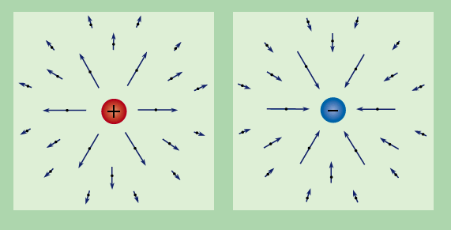
Electric Charge – The specifics
The symbol for CHARGE is “q”
The unit is the COULOMB(C), named after Charles Coulomb
If we are talking about a SINGLE charged particle such as 1 electron or 1 proton we are referring to an ELEMENTARY charge and often use, e , to symbolize this.
Some important constants:
Particle | Charge | Mass
Proton | 1.6x10⁻¹⁹ C | 1.67 x10⁻²⁷ kg
Electron | 1.6x10⁻¹⁹ C | 9.11 x10⁻³¹ kg
Neutron | 0 | 1.67 x10⁻²⁷ kg

Slide 4
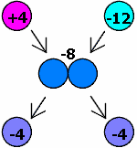
Charge is “CONSERVED”
Charge cannot be created or destroyed only transferred from one object to another. Even though these 2 charges attract initially, they repel after touching. Notice the NET charge stays the same.

Slide 5
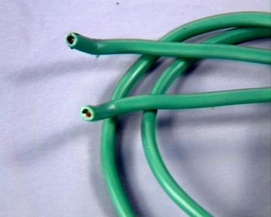
Conductors and Insulators
The movement of charge is limited by the substance the charge is trying to pass through. There are generally 2 types of substances.
Conductors: Allow charge to move readily though it.
Insulators: Restrict the movement of the charge
Conductor = Copper Wire
Insulator = Plastic sheath

Slide 6

Charging and Discharging
There are basically 2 ways you can charge something.
Charge by friction
Induction
“BIONIC is the first-ever ionic formula mascara. The primary ingredient in BIONIC is a chain molecule with a positive charge. The friction caused by sweeping the mascara brush across lashes causes a negative charge. Since opposites attract, the positively charged formula adheres to the negatively charged lashes for a dramatic effect that lasts all day.”

Slide 7
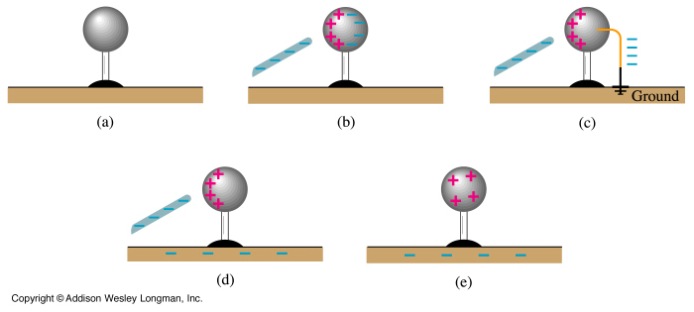
Induction and Grounding
The second way to charge something is via INDUCTION, which requires NO PHYSICAL CONTACT.
We bring a negatively charged rod near a neutral sphere. The protons in the sphere localize near the rod, while the electrons are repelled to the other side of the sphere. A wire can then be brought in contact with the negative side and allowed to touch the GROUND. The electrons will always move towards a more massive objects to increase separation from other electrons, leaving a NET positive sphere behind.

Slide 8
Electric Force
The electric force between 2 objects is symbolic of the gravitational force between 2 objects. RECALL:

Slide 9
Electric Forces and Newton’s Laws
Electric Forces and Fields obey Newton’s Laws.
Example: An electron is released above the surface of the Earth. A second electron
directly below it exerts an electrostatic force on the first electron just great enough to cancel out the gravitational force on it. How far below the first electron is the second?
F_{e}
e
mg
5.1 m
r = ?
e

Slide 10
Electric Forces and Vectors
Electric Fields and Forces are ALL vectors, thus all rules applying to vectors must be followed.
Consider three point charges, q₁ = 6.00 x10⁻⁹ C (located at the origin),q₃ = 5.00x10⁻⁹ C, and q₂ = -2.00x10⁻⁹ C, located at the corners of a RIGHT triangle. q₂ is located at y= 3 m while q₃ is located 4m to the right of q₂. Find the resultant force on q₃.
4m
Which way does q2 push q3?
Which way does q1 push q3?
q2
q3
3m
F_{on 3 due to 1}
5m
θ
q1
F_{on 3 due to 2}
θ = 37
q3
θ= tan⁻¹(3/4)

Slide 11
Example Cont’
4m
q2
q3
3m
F_{on 3 due to 1}
5m
θ
q1
F_{on 3 due to 2}
F_{3,1}sin37
θ = 37
θ= tan⁻¹(3/4)
q3
F_{3,1}cos37
5.6 x10⁻⁹ N
7.34x10⁻⁹ N
1.1x10⁻⁸ N
64.3 degrees above the +x

Slide 12
Coulomb’s Law is used to find the MAGNITUDE only!
In Figure A, we see that "i" is added
to justify a direction on the x-axis.
In figure B, we see that "j" is added
to justify a direction on the +Y-axis.
In figure C, we see a way to express
the force in terms of polar notation!
The angle is actually, measured
counter clockwise from the horizontal.

Slide 13
Example
Two weights of mass m = 0.25 kg are attached to separate strings of length L = 0.4 m and hung from a common point on the ceiling. When a charge "q" is placed on each mass, the masses repulse and swing out away from one another forming an angle of 22 degrees. What is the charge q?
0.076 m
0.153 m
11
r
T
11
L=0.4m
F_{E}
1.11 x 10⁻⁶ C or 1.11μC
mg

Slide 14
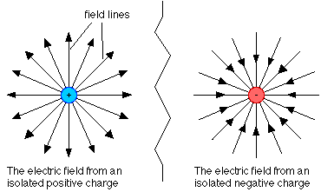
Electric Fields
By definition, these are “LINES OF FORCE”
Some important facts:
An electric field is a vector
Always is in the direction that a POSITIVE “test” charge would move
The amount of force PER “test” charge
If you placed a 2nd positive charge (test charge), near the positive charge shown above, it would move AWAY.
If you placed that same charge near the negative charge shown above it would move TOWARDS.

Slide 15
Electric Fields and Newton’s Laws
Once again, the equation for ELECTRIC FIELD is symbolic of the equation for WEIGHT just like coulomb’s law is symbolic of Newton’s Law of Gravitation.
The symbol for Electric Field is, “E”. And since it is defined as a force per unit charge the unit is Newtons per Coulomb, N/C.
NOTE: the equations above will ONLY help you determine the MAGNITUDE of the field or force. Conceptual understanding will help you determine the direction.
The “q” in the equation is that of a “test charge”.

Slide 16
Example
An electron and proton are each placed at rest in an external field of 520 N/C. Calculate the speed of each particle after 48 ns
What do we know
m_{e}=9.11 x 10⁻³¹ kg
m_{p}= 1.67 x10⁻²⁷ kg
q_{both}=1.6 x10⁻¹⁹ C
v_{o} = 0 m/s
E = 520 N/C
t = 48 x 10⁻⁹ s
8.32 x10⁻¹⁷ N
9.13x10¹³ m/s/s
4.98 x10¹⁰ m/s/s
4.38 x10⁶ m/s
2.39 x10³ m/s

Slide 17
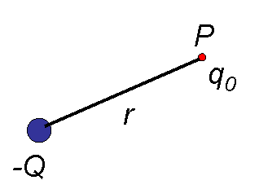
An Electric Point Charge
As we have discussed, all charges exert forces on other charges due to a field around them. Suppose we want to know how strong the field is at a specific point in space near this charge the calculate the effects this charge will have on other charges should they be placed at that point. Likewise for a very small amount of charge.
TEST CHARGE
POINT CHARGE

Slide 18
Example
A -4x10⁻¹²C charge Q is placed at the origin. What is the magnitude and direction of the electric field produced by Q if a test charge were placed at x = -0.2 m ?
0.2 m
E
0.899 N/C
E
-Q
E
Towards Q to the right
E
Remember, our equations will only give us MAGNITUDE. And the electric field LEAVES POSITIVE and ENTERS NEGATIVE.

Slide 19
Electric Field of a Conductor
A few more things about electric fields, suppose you bring a conductor NEAR a charged object. The side closest to which ever charge will be INDUCED the opposite charge. However, the charge will ONLY exist on the surface. There will never be an electric field inside a conductor. Insulators, however, can store the charge inside.
There must be a negative charge on this side OR this side was induced positive due to the other side being negative.
There must be a positive charge on this side

Slide 20
Extended Charge Distributions
All we have done so far has been dealing with specific POINTS in space. What if we are dealing with an OBJECT that has a continuous amount of charge over its surface?
Consider a hoop of radius R with a
total charge of Q distributed
uniformly on its surface. Let's
derive an expression for the electric
field at distance “b” units down the
+x axis.
We begin by defining a differential charge dq at some arbitrary position on the loop. This differential amount of charge will produce a differential
electric field dE at x=b

Slide 21
Extended Charge Distributions
We begin by defining a differential charge dq at some arbitrary position on the loop. This differential amount of charge will produce a differential
electric field dE at x=b
r
θ
dEcosθ
θ
dEsinθ
dE
What is r, the separation distance from the dq to point b?

Slide 22
Extended Charge Distributions
What is r, the separation distance from the dq to point b?
r
R
r
dEcosθ
b
θ
θ
dEsinθ
dE

Slide 23
Extended Charge Distributions
r
θ
dEcosθ
θ
dEsinθ
dE
That is for ONE very small amount of charge! To find the TOTAL E-field for each an every little dq, we would need to???
INTEGRATE!

Slide 24
Extended Charge Distributions
How do we know we did it right?
Let’s make b >>>> R, then R would be so tiny that from that distance the hoop would look like a point.
So if R went to ZERO, then the expression would look like:
It is the SAME equation as that of a point charge!

Slide 25
Extended Charge Distributions
Assume that for an “insulating” disk the charge is distributed throughout its area. We must use the SAME technique to derive the moments of inertia. Except, instead of the mass being distributed, it is the CHARGE.

Slide 26
Extended Charge Distributions
We still need to apply the limits!

Slide 27
Extended Charge Distributions
Let’s make R >>>>> b, in other words we are looking at the disk UP CLOSE.
Thus b approaches ZERO and R would go to infinity. What happens?
What does this mean?
The electric field, when distributed over an area is INDEPENDENT of separation distance. This means that the field is CONSTANT at all points away from the area.

Slide 28
Your turn (let’s take it step by step)
What is the electric field, E, as a function of r. for an INFINITE LINE of charge (a.k.a “a very long rod”). Begin with the horizontal!
+
+
r
What is dq equal to?
+
+
y
+
+
+
+
+
x
+
+
+

Slide 29
Your turn (let’s take it step by step)
What is the electric field, E, as a function of r. for a LINE of charge (a.k.a “a rod”). Begin with the horizontal!
+
What is dE_{x} equal to?
+
r
+
+
y
+
+
+
+
+
x
+
+
+

Slide 30
Your turn (let’s take it step by step)
What is the electric field, E, as a function of r. for a LINE of charge (a.k.a “a rod”). Begin with the horizontal!
+
What is E_{x} equal to?
+
r
+
+
y
+
+
+
+
+
x
+
+
+
By making x = r, we are saying this is the electric field along a line parallel to the rod a distance, x, or r in this case , away.

Slide 31
What about the “y” direction?
The equation is identical except for HOW you solve the integration. In the horizontal we could bring the “x” out because it was constant. In this case, the “y” CANNOT be brought out as the dq varies in height above and below the origin. So the “y” is a CHANGING variable.
ZERO!
The “y” components CANCEL out above an below the rod. The ones below the origin extend upward and the ones above the rod extend downwards. The symmetry CAUSES the components to cancel out.

Slide 32
In summary
All of the electric charge distributions were derived from that of a point charge.
Distributions can produce different functions depending on whether the charge is distributed over a LENGTH, AREA, or VOLUME.
Function | Point, hoop, or Sphere (Volume) | Disk or Sheet (AREA) | Line, rod, or cylinder (LINEAR)
Equation
These equations are important for later so keep these in mind!

